Slide 1
WebGPU Flowing Shallow Waves
2025 Fall CIS 565 Final Project
Milestone 2 Presentation
Qirui Fu Pavel Peev
Tianhong Zhou

Slide 2
Content
Overview
Implementation in Milestone 2
Simulation Part
Work for next mileston

Slide 3
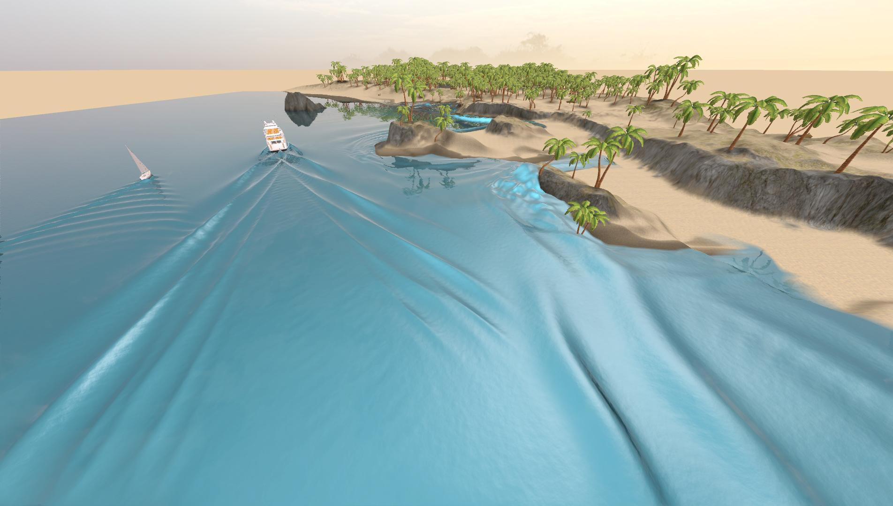
Project Overview
Reproduce Generalizing Shallow Water Simulation with Dispersive Surface Waves (SIGGRAPH 2023) model using WebGPU
Real-time, large-scale water wave propagation
Interactive control features
Generalizing Shallow Water Simulation with Dispersive Surface Waves (Stefan Jeschke and Chris Wojtan)

Slide 4
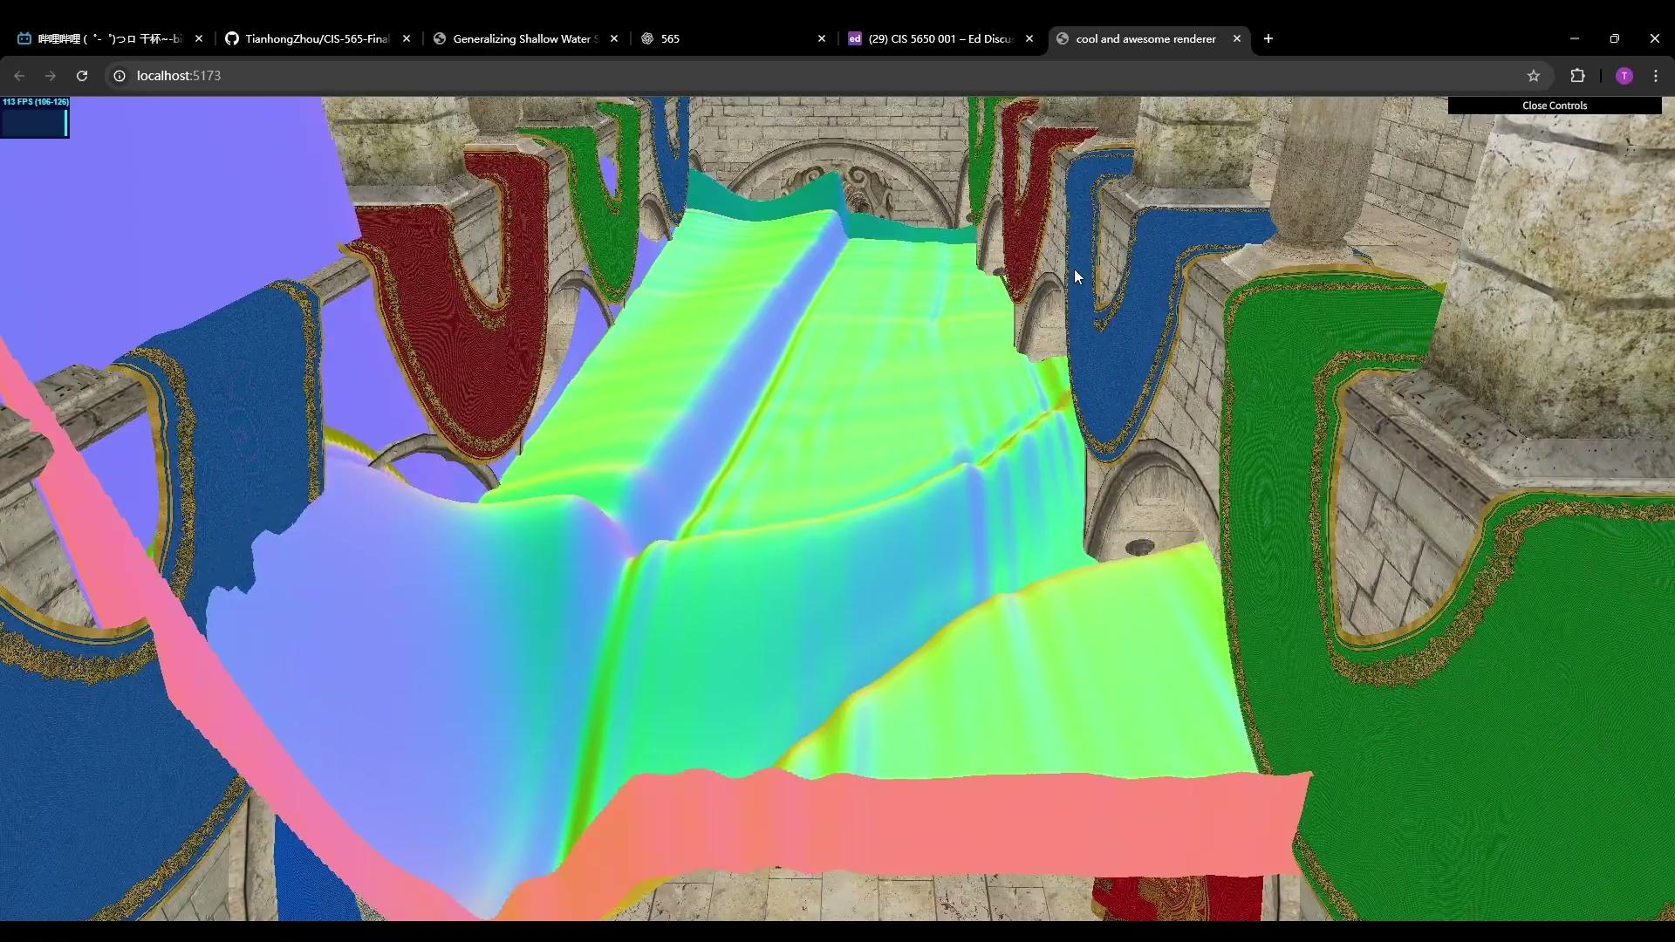
Milestone 2 Demo

Slide 5
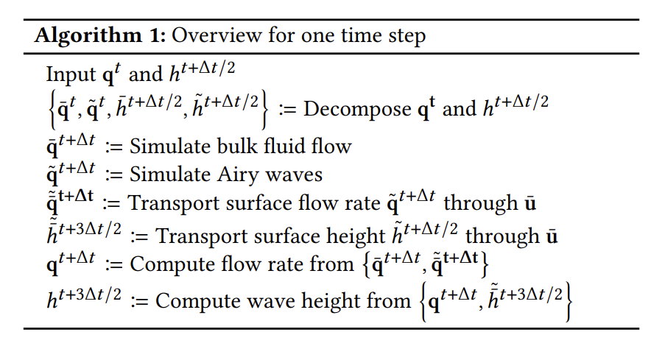
Implementation in Milestone 2
Finished in Milestone 1
Pavel
Tianhong
Qirui
Tianhong

Slide 6
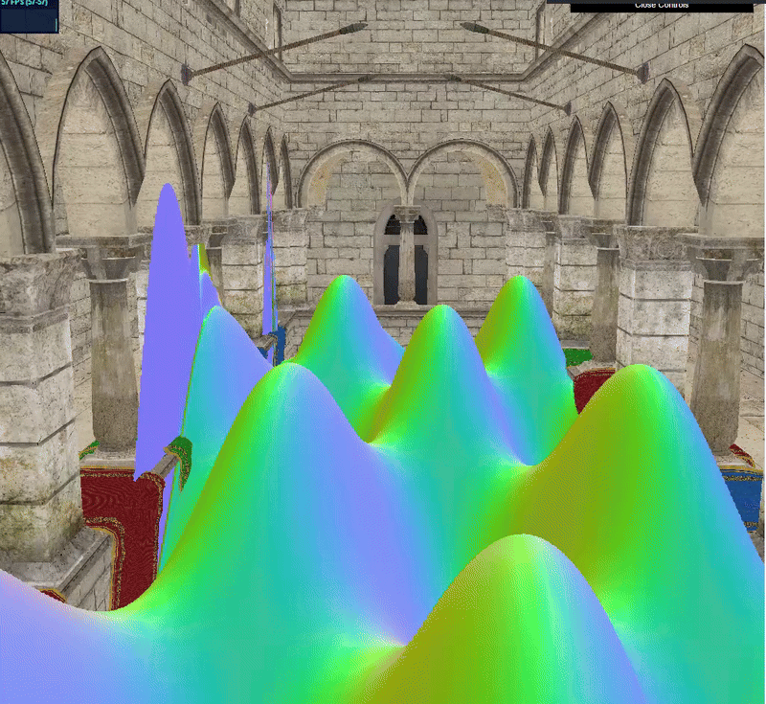
Implementation in Milestone 2
Bulk Fluid Flow
Updates low frequency Heights and Flows
Currently explodes
Potential problems with boundary conditions lead to unstable sim.

Slide 7
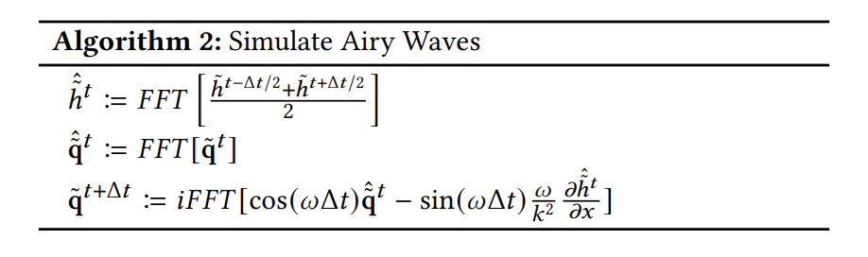
Implementation in Milestone 2
Airy Waves
FFT and inverse FFT for calculating height and flux
No WebGPU FFT Library
Tried to use CPU Web FFT Library
240 FPS -> 20 FPS
Implement a WebGPU FFT

Slide 8
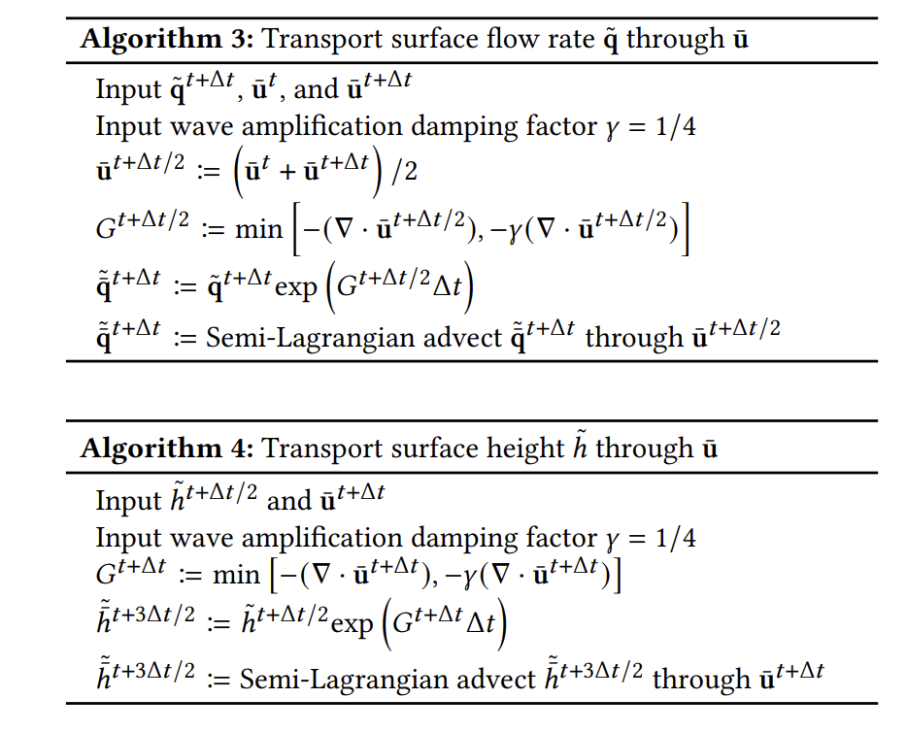
Implementation in Milestone 2
Transport Surface
The main parts for two algorithms are the same
One pipeline, one shader, only different inputs

Slide 9
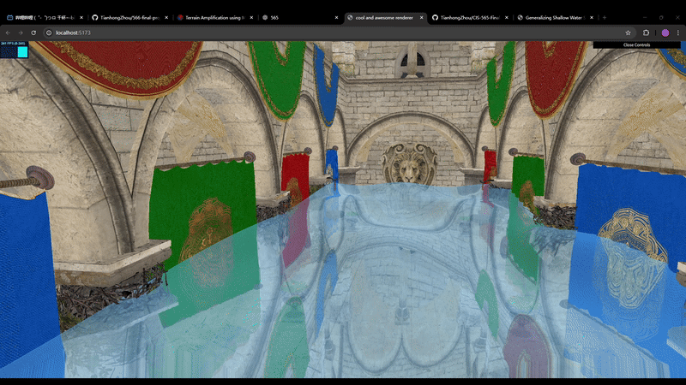
Work for future milestones
Fix bugs in Simulator
Combine Rendering & Simulation

Slide 10
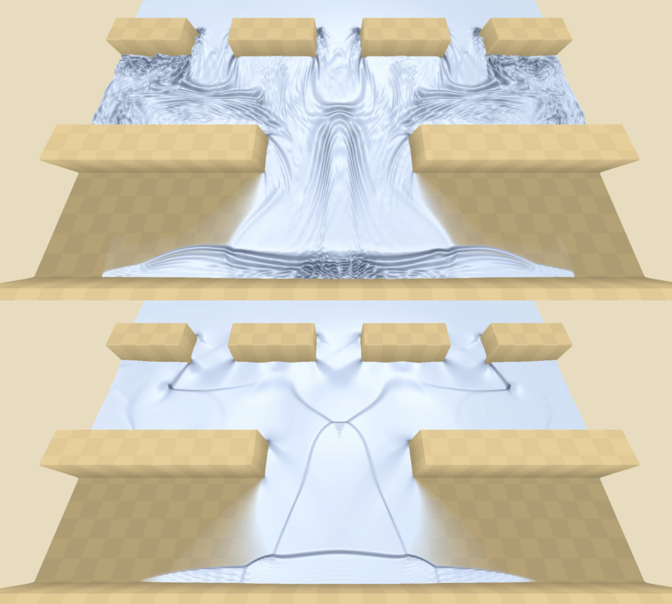
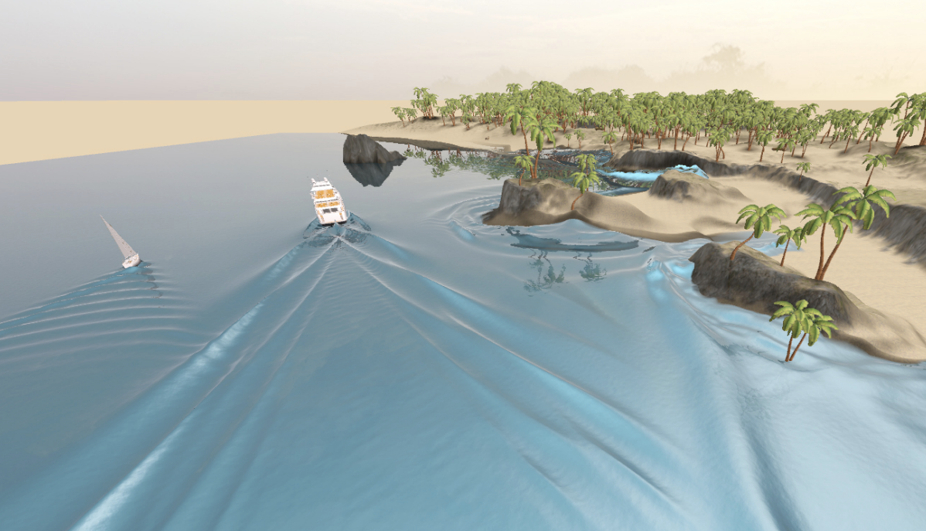
Work for future milestones
Interaction with boats, terrain and boundary conditions

